Slide 1


The health, poverty and financial consequences of a cigarette price increase among 500 million male smokers in 13 middle-income countries
Release date: BMJ, April 11, 2018 23:30 pm UK time,
18:30 Toronto, 04:00 (April 12) in Delhi
www.cghr.org/smoking
Twitter: @CGHR_org and @countthedead
prabhat.jha@utoronto.ca

Slide 2

Key messages (1 of 2)
A 50% increase in cigarette prices would lead to about 450 million years of life gained across the 13 countries due to quitting.
The poorest 20% of male smokers would gain an average of five times the life-years (per smoker) from quitting than the richest 20%.
Notes:
Possible tweets:
Key message- A substantial increase in cigarette prices would help millions of people around the world avoid poor health and extreme poverty
Second tweet- The findings show that people on low incomes have the most to gain, and the researchers say modest action by many governments “could yield unprecedented health gains and poverty reduction.”

Slide 3
Key messages (2 of 2)
USD $157 billion would be saved by avoiding treatment costs for medical conditions caused by smoking. The poorest 20% would avert far more medical costs than the richest 20%.
In the countries without universal health coverage, 9 million men, half of them in the poorest 20%, would avoid falling below the World Bank’s extreme poverty line.
USD $122 billion of additional tobacco tax would be collected, with the richest 20% paying twice as much as the poorest 20%.
Notes:
Possible tweets:
Key message- A substantial increase in cigarette prices would help millions of people around the world avoid poor health and extreme poverty
Second tweet- The findings show that people on low incomes have the most to gain, and the researchers say modest action by many governments “could yield unprecedented health gains and poverty reduction.”

Slide 4
What is already known
Smoking will kill 1 billion people this century
A large proportion of these deaths will occur in low and middle-income countries
In most countries, smoking prevalence and rates of smoking-attributable diseases are highest in the poor
WHO estimates that 100 million individuals fall into poverty every year due to out of pocket health expenditures, with much of these expenditures for treating tobacco-related diseases

Slide 5
What is already known
Effective tobacco control could avoid hundreds of millions of premature deaths this century
Tobacco taxation is the single most effective intervention to get smokers to quit
Low-income groups are more responsive to price increases than high-income groups
Notes:
The effects of taxes are greatest among youth and persons with low income
Higher excise taxes increase government revenue, which can be used for pro-poor health and other programs. However, high excise taxes, at the levels recommended by WHO and the World Bank¹¹ remain uncommon in most LMICs

Slide 6
What’s new about this research?
This is the largest study to directly quantify the potential impact of a tobacco price increase across income groups covering 2 billion population and 500 million male smokers
No other studies have assessed the impact of higher tobacco taxes on health and financial outcomes across a range of countries
Notes:
Our results challenge the conventional view that tobacco taxes hurt the poor.
Despite differences in socio-economic condition and health financing arrangements, tobacco taxation through a 50% price increase strongly favours the bottom income quintile of the population in terms of life-years saved, out-of-pocket expenditures from tobacco-attributable treatment costs averted, and individuals avoiding catastrophic health expenditures or poverty.

Slide 7
What’s new about this research?
Higher cigarette taxes are an effective tool to improve health and to reduce global poverty and the results are consistent across 13 diverse middle income countries
In these 13 countries alone, some 450 million life-years would be saved from higher excise taxes, contributing substantially to the United Nations target of a one-third reduction in NCD death rates at ages 30-69 years by 2030
Notes:
Our results challenge the conventional view that tobacco taxes hurt the poor.
Despite differences in socio-economic condition and health financing arrangements, tobacco taxation through a 50% price increase strongly favours the bottom income quintile of the population in terms of life-years saved, out-of-pocket expenditures from tobacco-attributable treatment costs averted, and individuals avoiding catastrophic health expenditures or poverty.

Slide 8
What’s new about this research?
If implemented worldwide, higher taxes that raise cigarette prices by 50% would avoid about 20 million people falling into poverty
  Point of comparison: 30 million avoid poverty every year from all other reasons (such as economic growth, trade, etc).
Higher tobacco excise taxes are a powerful but generally underused tool to reduce expenditures on disease treatments that lead to poverty
Notes:
Our results challenge the conventional view that tobacco taxes hurt the poor.
Despite differences in socio-economic condition and health financing arrangements, tobacco taxation through a 50% price increase strongly favours the bottom income quintile of the population in terms of life-years saved, out-of-pocket expenditures from tobacco-attributable treatment costs averted, and individuals avoiding catastrophic health expenditures or poverty.

Slide 9
How was the study done?
Our static model examined the impact of a large cigarette price increase on:
  life-years gained
  averted treatment cost
  individuals avoiding catastrophic health expenditures & poverty
  additional tax revenue
  by income groups in 13 middle-income countries covering 500 million male smokers*
This is the largest modeling study of its kind
*90% of all smokers in these countries were men
This paper was funded by research agencies, who had no role in the analyses or writing of the paper
Notes:
No tweet

Slide 10
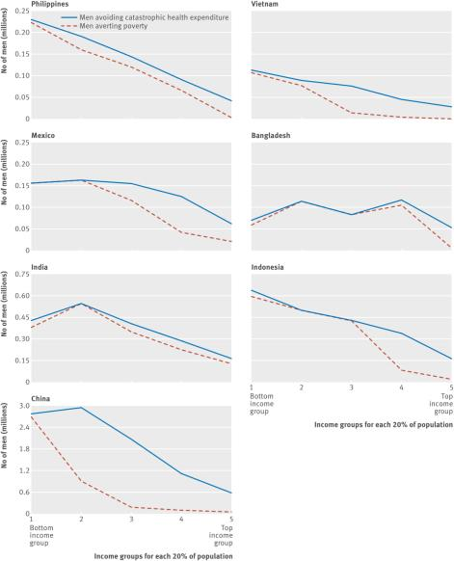
Philippines
Philippines
Vietnam
Figure 1A
Number of individuals avoiding catastrophic health expenditures and averting extreme poverty
Mexico
Bangladesh
India
Indonesia
Catastrophic health expenditure is defined as >10% of individual’s annual income and extreme poverty is the World Bank’s international poverty line of income of USD $1.90/day in PPP
China
Notes:
The 50% higher cigarette price would lead to about 15.5M men avoiding catastrophic health expenditures and 8.8M men avoiding extreme poverty, including 4.2M in the bottom income quintile (median 37%, range 16-68%) and 2.5M would be in the second lowest income quintile.
Nearly all of the extreme poverty avoided was in the bottom income quintile.
The 8.8M men represent 2.4% of the baseline number of 360M men and women living in extreme poverty in these seven countries.
In most countries, there is an inverse relationship between income quintile and number of individuals who will avoid catastrophic healthcare expenditures or poverty.
However, in Bangladesh, a sizeable number of men who would avoid poverty and catastrophic healthcare expenditures would be from the fourth income quintile due to the relatively high prevalence of smoking in this income group.

Slide 11
  Figure 1B
  Life-years gained per smoker by age and income
Bottom and top quintiles refer to the poorest 20% and richest 20% of the population

Slide 12
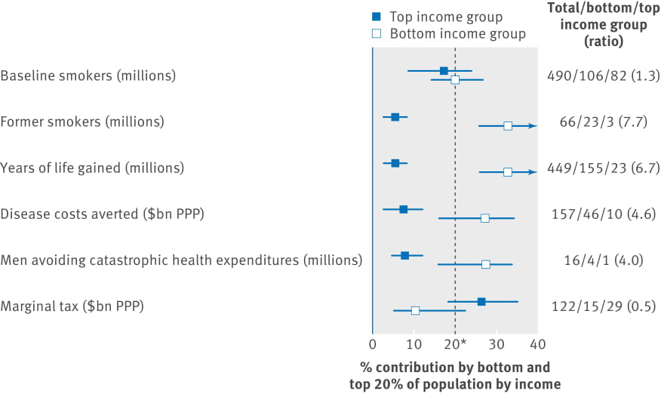
Figure 2
Share of health and financial benefits accruing to the bottom and top income groups of the population
*Expected value if there are no differences across bottom and top
Notes:
Overall, the bottom income quintile would get 31% of the life-years saved, and 29% each of the averted disease costs and averted catastrophic health expenditures but pay only 10% of the additional taxes.
Smoking is 1.3 times as common in the bottom income quintile as the top.
However, because smokers in the bottom income quintile are more likely to quit than those in the higher quintile, the bottom income quintile would receive a significantly larger share of the health and financial benefits in terms of years of life gained, disease costs averted, and number of individuals avoiding catastrophic health expenditures.

Slide 13
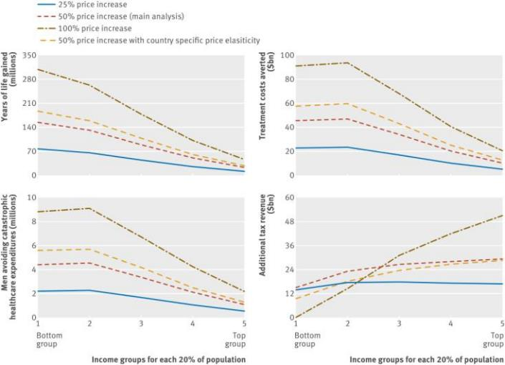
Figure 3
Sensitivity analysis for health and financial outcomes by varying degree of tobacco price increase and using country-specific elasticities
All USD are in PPP
Notes:
The ratio of catastrophic health expenditures avoided by the bottom versus top income quintiles was 4 for all 13 countries and similar (3.5) in the 11 countries after exclusion of China and India.
This ratio was similar (3.3) if we included female smokers from three countries where the proportion of female smokers to total smokers is relatively high (Chile at 46%, Colombia at 29% and Mexico at 29%).
Use of lower or higher price increases or country-specific elasticities showed slightly greater ratios for the bottom versus top income quintiles.
The additional tax burden from a 100% price increase would be borne mostly by the top quintile.

Slide 14
Common misconceptions about higher tobacco taxes
Misconception: | Evidence:
“Higher tobacco taxes hurt the poor” | Poorer smokers are more price responsive than richer smokers, and quit (or smoke less) in greater proportion with higher taxes. Hence, the health benefits are strongly concentrated in poorer smokers Higher taxes may lead to some smokers switching down to cheaper cigarettes. Governments need to implement a large, simplified tax system to prevent such switching Higher taxes enable higher tax revenue, which may be used to improve health and other social services for the poor

Slide 15
Common misconceptions about higher tobacco taxation
Misconception: | Evidence:
2. “Higher tobacco taxes lead to more illegal activities like smuggling” | Higher taxes raise both official and black market retail prices. Legal and illegal tobacco are not perfect substitutes because of high costs involved in consuming illegal products The main determinant of smuggling is not price, but lax enforcement of customs and tolerance for organized criminal smuggling networks Even in the face of moderate smuggling, higher excise taxes prices reduce consumption and increase revenue

Slide 16
Common misconceptions about higher tobacco taxation
Misconception: | Evidence:
3. “Higher tobacco taxes reduce tobacco revenues” | The extra revenue per pack of cigarettes outweighs the reduced demand, yielding revenue increases WHO estimates that raising tobacco excise tax by 1 International Dollar (about US$ 0.80) in all countries would increase excise revenue by 47%, representing an extra USD $141 billion
4. “Higher tobacco taxes result in lost jobs” | Money not spent on tobacco does not disappear from the economy, but is spent on other goods and services that generate employment. Several reviews of even more extreme curtailing of tobacco use find that increases in tobacco taxes do not lead to net job losses (and even some gains)

Slide 17
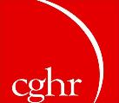


www.cghr.org/smoking
Full BMJ paper (free)
Press releases: English & Spanish
PowerPoint
Video press release
Links to other CGHR research

Slide 18
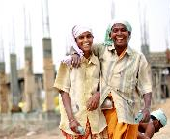
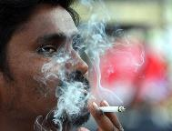
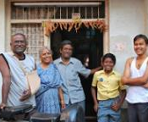
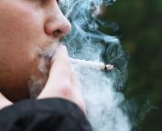

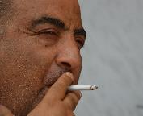
Save lives by raising cigarette taxes
www.cghr.org/smoking

